Slide 1
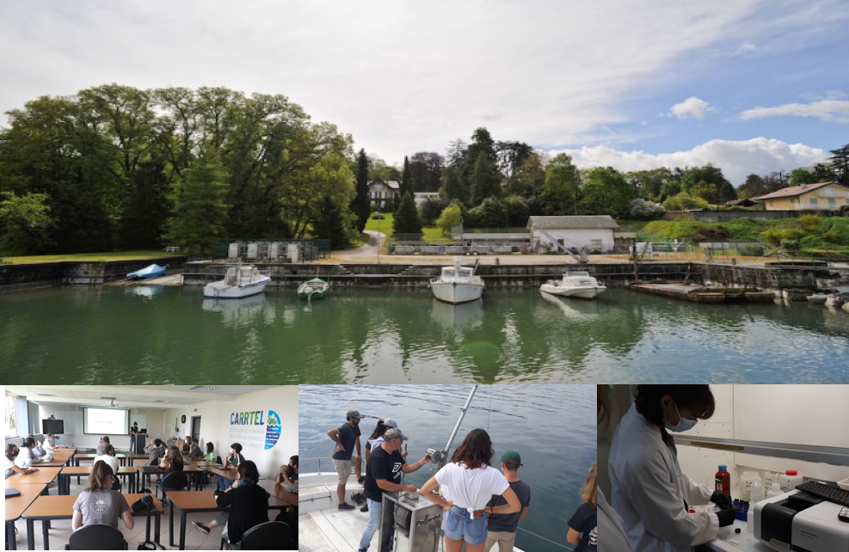
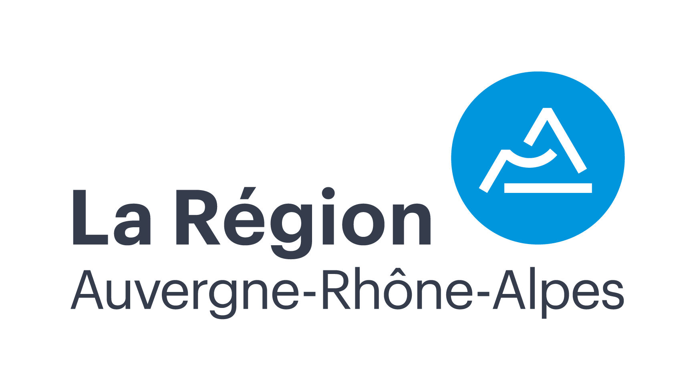
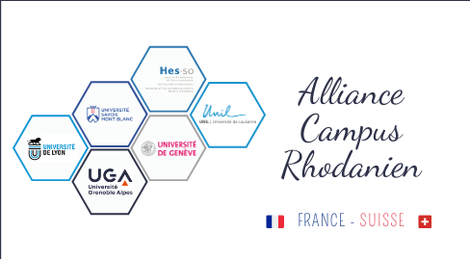
Summer School
«Lakes and rivers ecological monitoring»
Thonon les Bains 18-22 July 2022
Optional course training for 10 students from USMB and UNITO -- Master or Doctoral degree.
One week training to strengthen knowledge in lakes and rivers ecology (functioning of the food web, biochemical cycles, etc.) with a strong focus on tools and methods for ecosystem monitoring. The program will be based mainly on field samplings and practical workshops to present and apply current methods for understanding the functioning of aquatic ecosystems subject to several anthropogenic pressures.
Info and registration: please send your CV to serena.rasconi@inrae.fr
The training and accommodation in Thonon les Bains are offered by funding from Alliance Unita, Alliance Campus Rhodanien and Région Auvergne Rhône-Alpes

